Slide 1
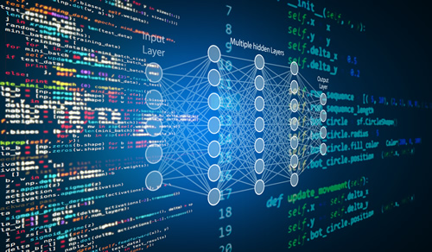
Jordon Bruton

Slide 2
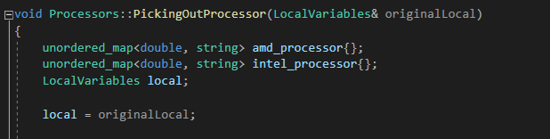
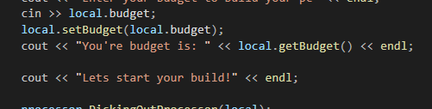
Something cool… Function parameters: - Used function parameters to not only keep track of how much the user spent, but also the parts that they decided on

Slide 3
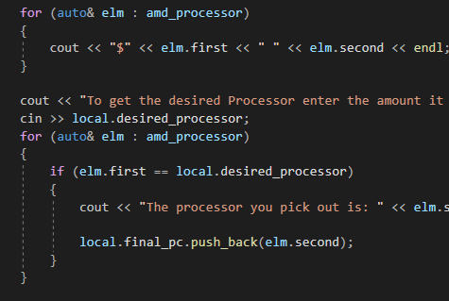
Using two different data structures in order to keep track of the desired parts of a PC in the simplest of ways

Slide 4

If I could do it all over again, I would…
Using a database in order to store the computer parts
Instead of using console use a GUI
Using a different data structure to hold PC parts
Integrating images

Slide 5

The thing that I learned the most was…
Better understanding of the implementation of unordered_maps
How helpful function parameters may be if you think of how they can be used outside of the box
References
Implementing classes

